Slide 1
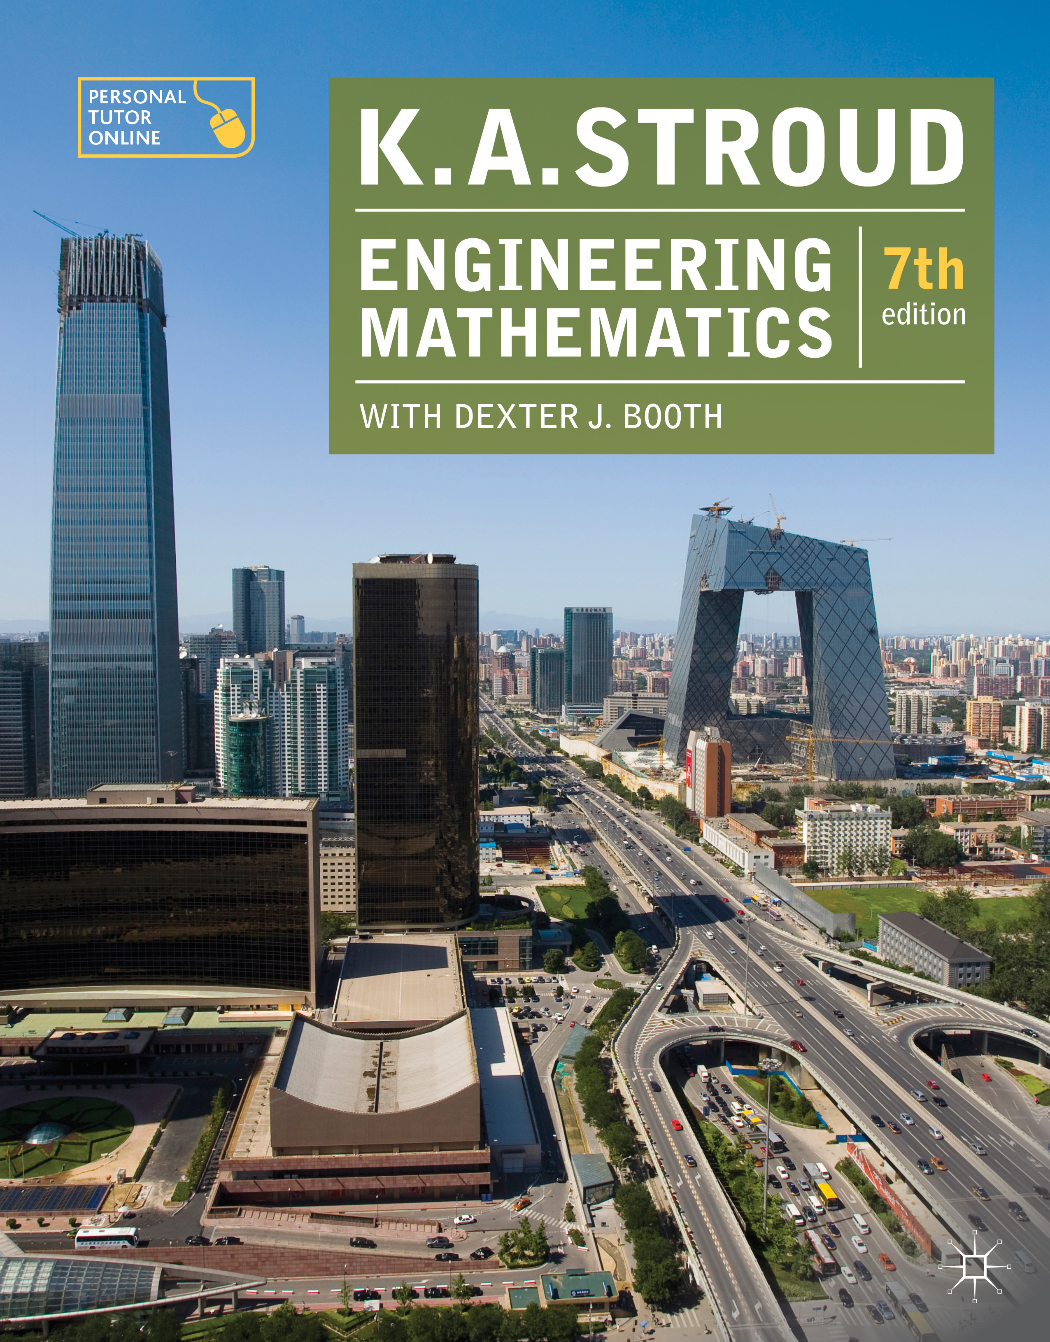
PROGRAMME 3
HYPERBOLIC FUNCTIONS

Slide 2
Introduction
Graphs of hyperbolic functions
Evaluation of hyperbolic functions
Inverse hyperbolic functions
Log form of the inverse hyperbolic functions
Hyperbolic identities
Relationship between trigonometric and hyperbolic functions

Slide 3
Introduction
Graphs of hyperbolic functions
Evaluation of hyperbolic functions
Inverse hyperbolic functions
Log form of the inverse hyperbolic functions
Hyperbolic identities
Relationship between trigonometric and hyperbolic functions

Slide 4
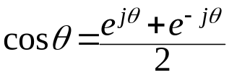

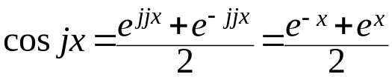
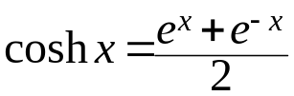
Introduction
Given that:
then:
and so, if
This is the even part of the exponential function and is defined to be the hyperbolic cosine:

Slide 5
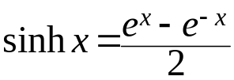
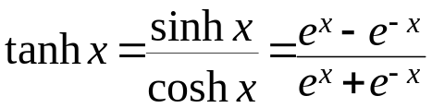
Introduction
The odd part of the exponential function and is defined to be the hyperbolic sine:
The ratio of the hyperbolic sine to the hyperbolic cosine is the hyperbolic tangent

Slide 6
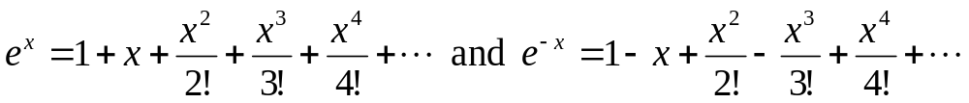
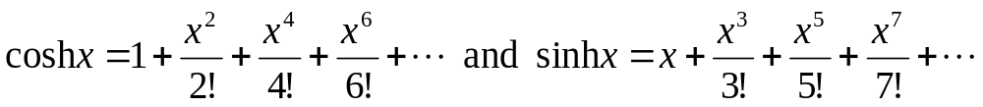
Introduction
The power series expansions of the exponential function are:
and so:

Slide 7
Introduction
Graphs of hyperbolic functions
Evaluation of hyperbolic functions
Inverse hyperbolic functions
Log form of the inverse hyperbolic functions
Hyperbolic identities
Relationship between trigonometric and hyperbolic functions

Slide 8
Introduction
Graphs of hyperbolic functions
Evaluation of hyperbolic functions
Inverse hyperbolic functions
Log form of the inverse hyperbolic functions
Hyperbolic identities
Relationship between trigonometric and hyperbolic functions

Slide 9
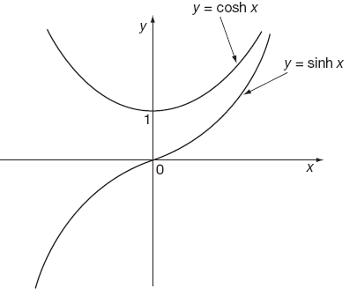
Graphs of hyperbolic functions
The graphs of the hyperbolic sine and the hyperbolic cosine are:

Slide 10
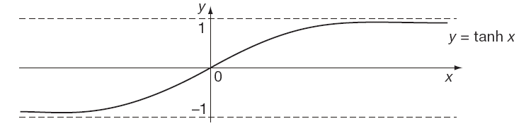
Graphs of hyperbolic functions
The graph of the hyperbolic tangent is:

Slide 11
Introduction
Graphs of hyperbolic functions
Evaluation of hyperbolic functions
Inverse hyperbolic functions
Log form of the inverse hyperbolic functions
Hyperbolic identities
Relationship between trigonometric and hyperbolic functions

Slide 12
Introduction
Graphs of hyperbolic functions
Evaluation of hyperbolic functions
Inverse hyperbolic functions
Log form of the inverse hyperbolic functions
Hyperbolic identities
Relationship between trigonometric and hyperbolic functions

Slide 13
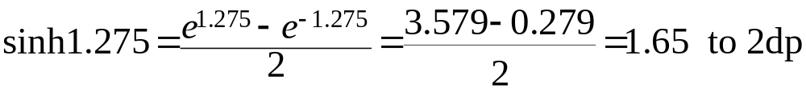
Evaluation of hyperbolic functions
The values of the hyperbolic sine, cosine and tangent can be found using a calculator.
If your calculator does not possess these facilities then their values can be found using the exponential key instead.
For example:

Slide 14
Introduction
Graphs of hyperbolic functions
Evaluation of hyperbolic functions
Inverse hyperbolic functions
Log form of the inverse hyperbolic functions
Hyperbolic identities
Relationship between trigonometric and hyperbolic functions

Slide 15
Introduction
Graphs of hyperbolic functions
Evaluation of hyperbolic functions
Inverse hyperbolic functions
Log form of the inverse hyperbolic functions
Hyperbolic identities
Relationship between trigonometric and hyperbolic functions

Slide 16
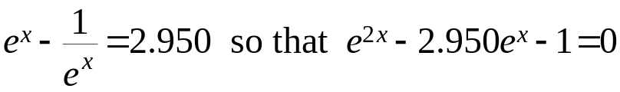
Inverse hyperbolic functions
To find the value of an inverse hyperbolic function using a calculator without that facility requires the use of the exponential function.
For example, to find the value of sinh⁻¹1.475 it is required to find the value of x such that sinh x = 1.475. That is:
Hence:

Slide 17
Introduction
Graphs of hyperbolic functions
Evaluation of hyperbolic functions
Inverse hyperbolic functions
Log form of the inverse hyperbolic functions
Hyperbolic identities
Relationship between trigonometric and hyperbolic functions

Slide 18
Introduction
Graphs of hyperbolic functions
Evaluation of hyperbolic functions
Inverse hyperbolic functions
Log form of the inverse hyperbolic functions
Hyperbolic identities
Relationship between trigonometric and hyperbolic functions

Slide 19
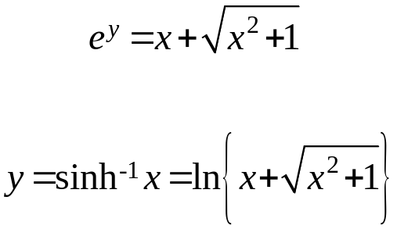
Log form of the inverse hyperbolic functions
If y = sinh⁻¹x then x = sinh y. That is:
therefore:
So that

Slide 20
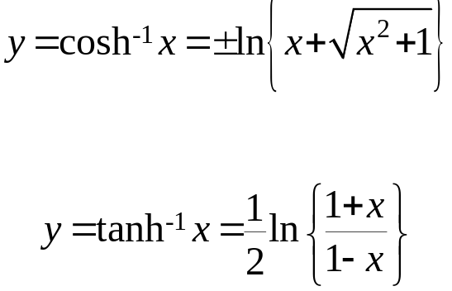
Log form of the inverse hyperbolic functions
Similarly:
and

Slide 21
Introduction
Graphs of hyperbolic functions
Evaluation of hyperbolic functions
Inverse hyperbolic functions
Log form of the inverse hyperbolic functions
Hyperbolic identities
Relationship between trigonometric and hyperbolic functions

Slide 22
Introduction
Graphs of hyperbolic functions
Evaluation of hyperbolic functions
Inverse hyperbolic functions
Log form of the inverse hyperbolic functions
Hyperbolic identities
Relationship between trigonometric and hyperbolic functions

Slide 23
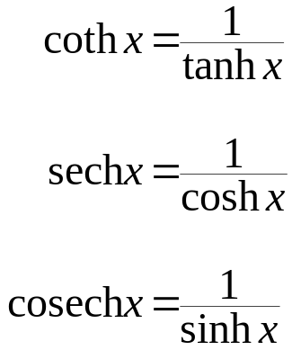
Hyperbolic identities
Reciprocals
Just like the circular trigonometric ratios, the hyperbolic functions also have their reciprocals:

Slide 24
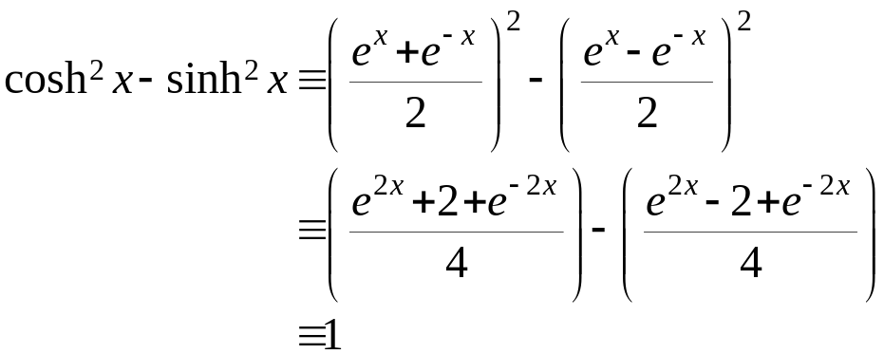

Hyperbolic identities
From the definitions of coshx and sinhx:
So:

Slide 25
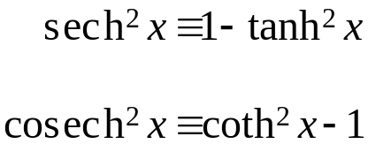
Hyperbolic identities
Similarly:

Slide 26
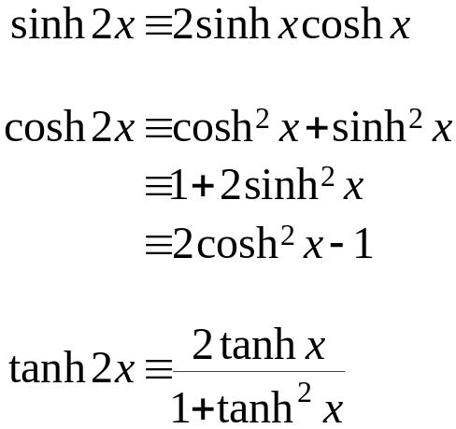
Hyperbolic identities
And:
A clear similarity with the circular trigonometric identities.

Slide 27
Introduction
Graphs of hyperbolic functions
Evaluation of hyperbolic functions
Inverse hyperbolic functions
Log form of the inverse hyperbolic functions
Hyperbolic identities
Relationship between trigonometric and hyperbolic functions

Slide 28
Introduction
Graphs of hyperbolic functions
Evaluation of hyperbolic functions
Inverse hyperbolic functions
Log form of the inverse hyperbolic functions
Hyperbolic identities
Relationship between trigonometric and hyperbolic functions

Slide 29
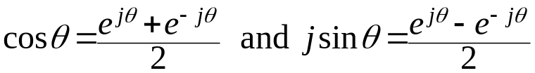
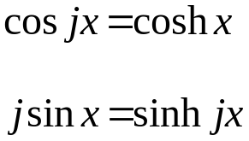
Relationship between trigonometric and hyperbolic functions
Since:
it is clear that for

Slide 30
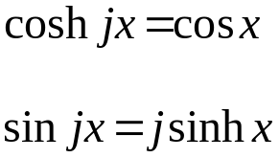
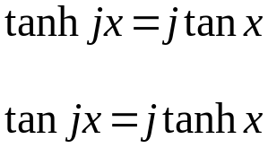
Relationship between trigonometric and hyperbolic functions
Similarly:
And further:

Slide 31
Learning outcomes
Define the hyperbolic functions in terms of the exponential function
Express the hyperbolic functions as power series
Recognize the graphs of the hyperbolic functions
Evaluate hyperbolic functions and their inverses
Determine the logarithmic form of the inverse hyperbolic functions
Prove hyperbolic identities
Understand the relationship between the circular and the hyperbolic trigonometric ssfunctions

